Slide 1
What can reactogenicity tell us about the COVIRS dataset?
Art Hussnain
Somebody..?

Slide 2


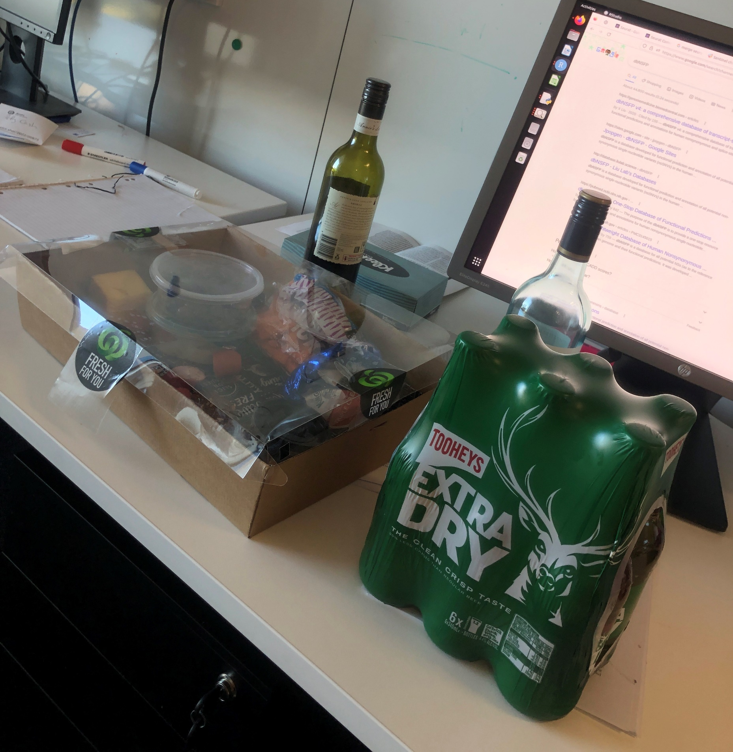
About… me!
21 and a half
2nd/3rd year of BSc
Favourite cafe:
Rundle General Store
Jobs I’ve had: tutor, respirator fitter, librarian, mushroom picker, bar manager, gardener, performer
Likes: biology, problems, music
Dislikes: unclear things
My desk most days…

Slide 3
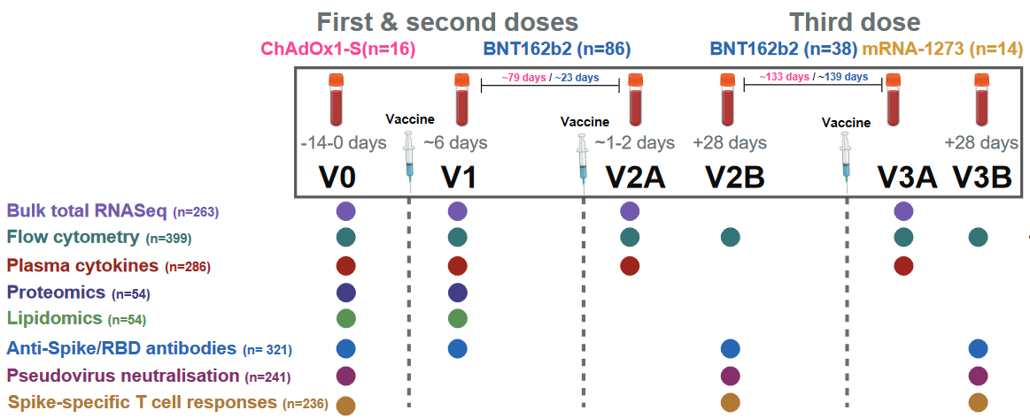
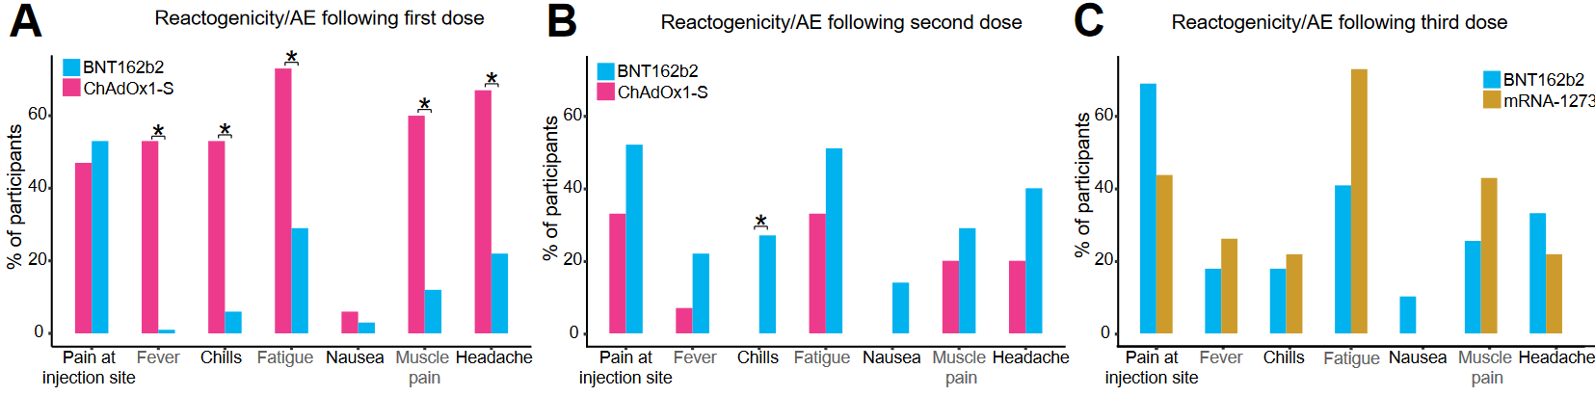
About COVIRS
RNAseq is overpowered – I wanted to learn more
COVIRS had RNAseq data, flow data, antibody data, etc.
Need groups to compare
Cluster participants by symptoms
Only Pfizer-vaccinated!
Bigger sample size (c. 80 vs 16)
More symptoms after second dose

Slide 4
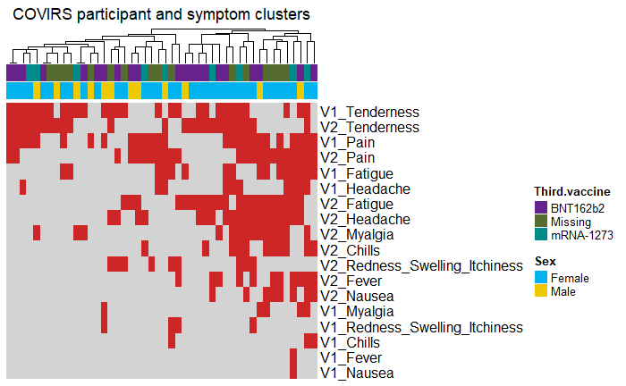
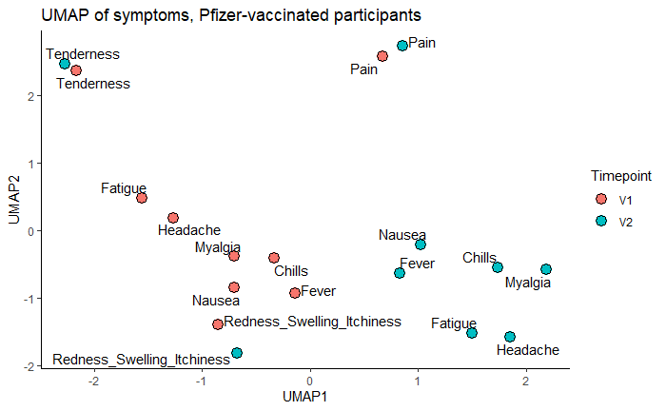
COVIRS participants appear to separate broadly in two groups

Slide 5
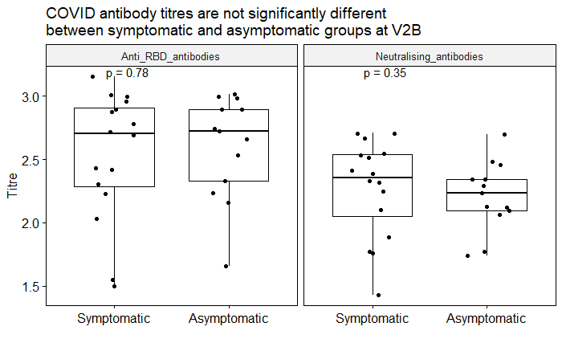
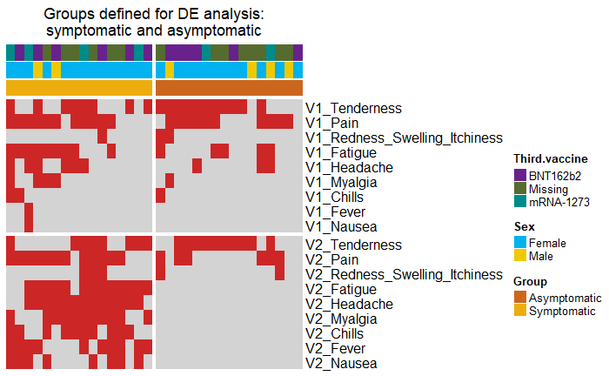
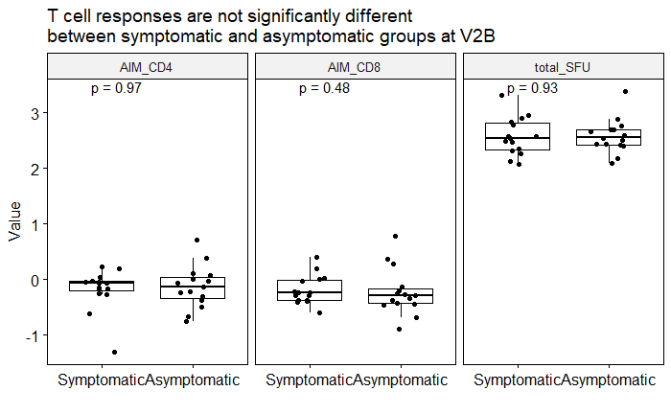
COVIRS participants appear to separate broadly in two groups
Asymptomatic = Two or less of V2 Tenderness, Pain, Redness/Swelling/Itchiness (n = 16)
Symptomatic = Two or more of V2 Fatigue, Headache, Myalgia, Chills, Fever, Nausea (n = 16)

Slide 6
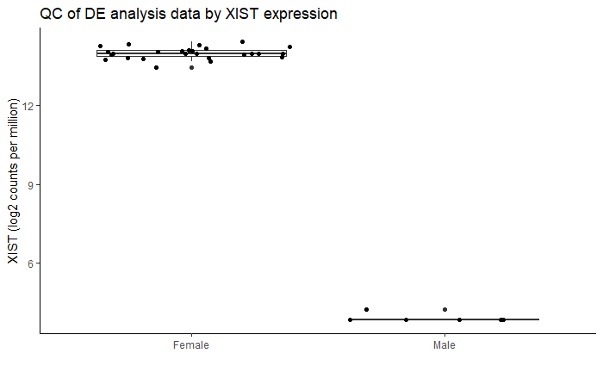
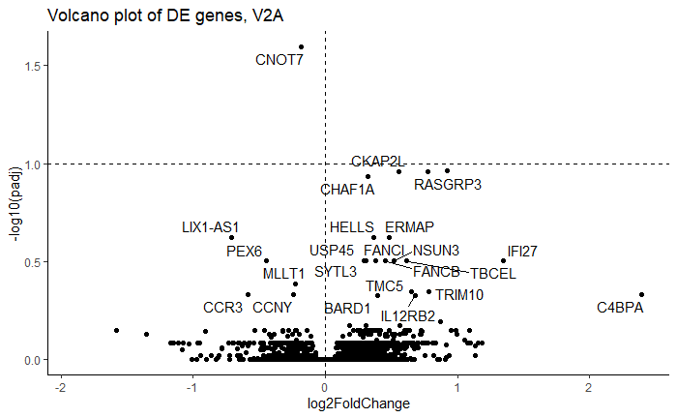
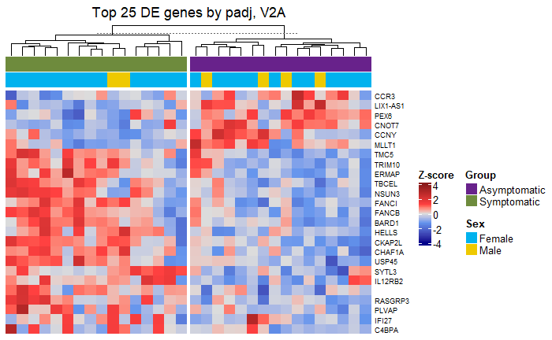
Few individual genes are significantly differentially expressed at V2
Only one gene significantly DE (padj < 0.1)
Gene set enrichment analysis (GSEA) - change to group of genes may be significant even if individual genes are not

Slide 7
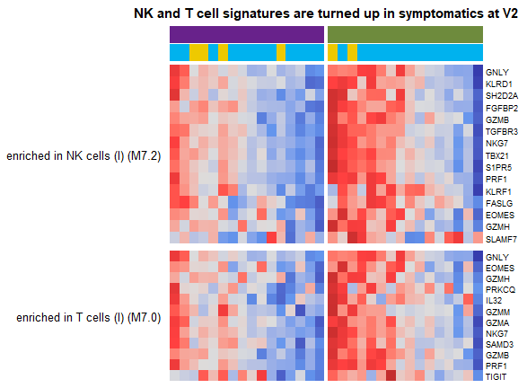
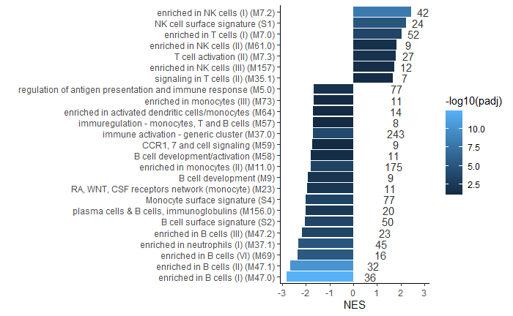
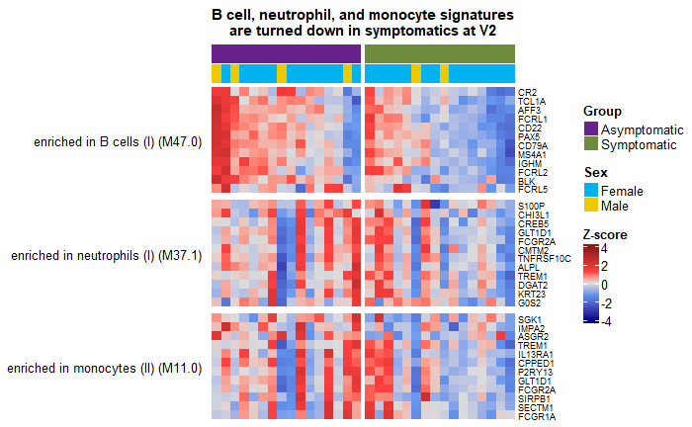
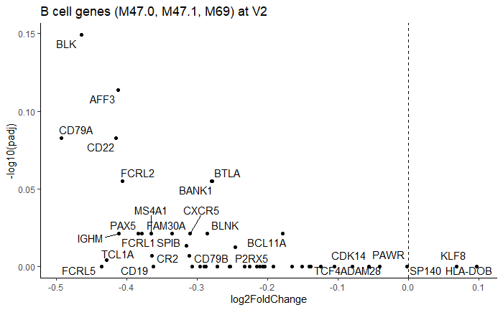
B cells, neutrophils, and monocytes are down; erythroblasts, NK and T cells are up in symptomatic group at V2

Slide 8
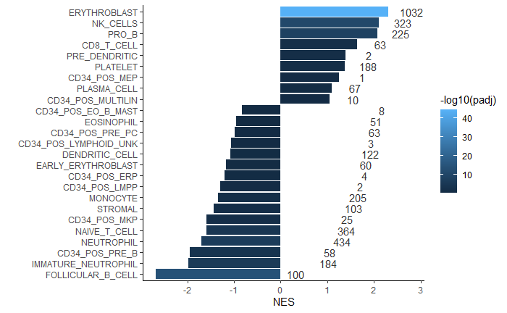
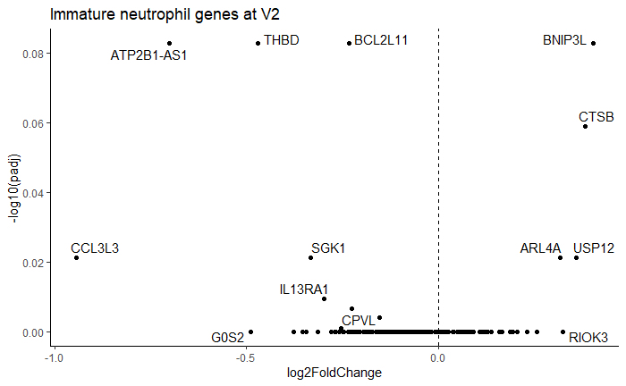
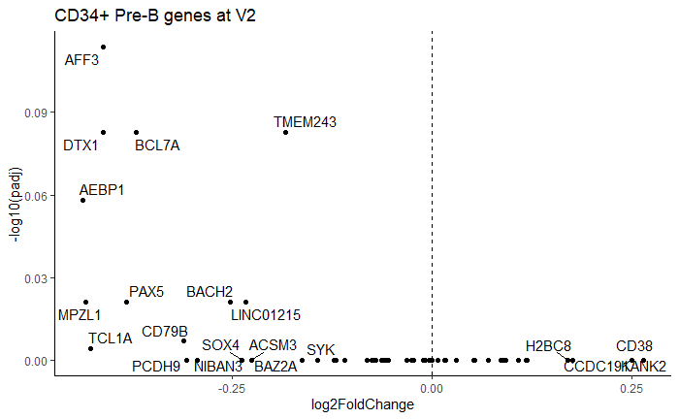
“Turned down” doesn’t always mean turned down
vs
NES = -1.97
padj = 4.7x10^-7
NES = -1.95
padj = 4.9x10^-4
Notes:
Heatmaps of top fold changing genes (in the right direction!) from interesting pathways sorted by padj. Order of genes in heatmap by clustering

Slide 9
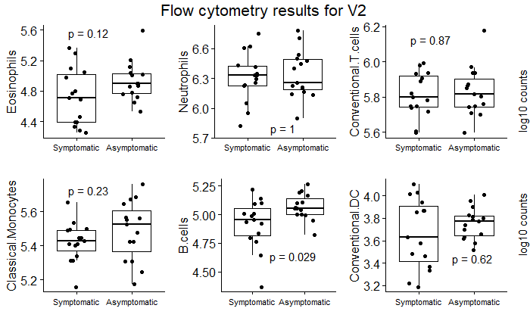
Flow cytometry confirms reduction in B cells at V2
V2 changes from GSEA
Up in symptomatic | NK cells, T cells
Down in symptomatic | B cells, neutrophils, monocytes
Where did the B cells go??

Slide 10
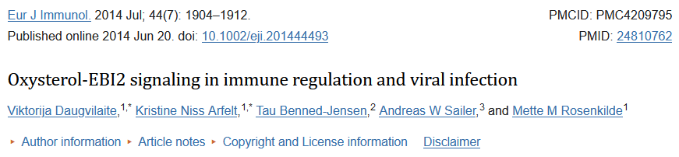
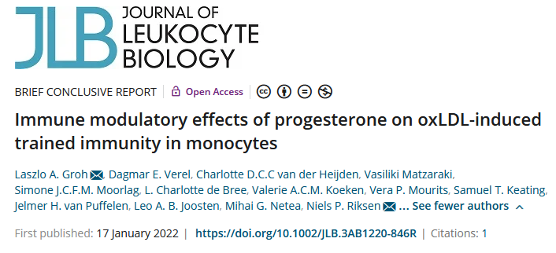
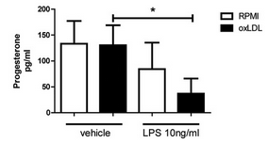
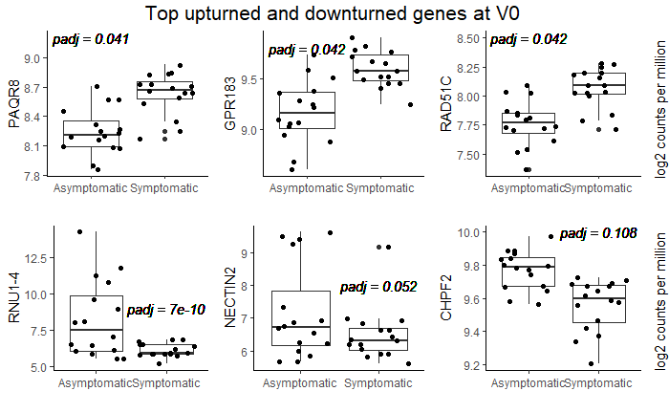
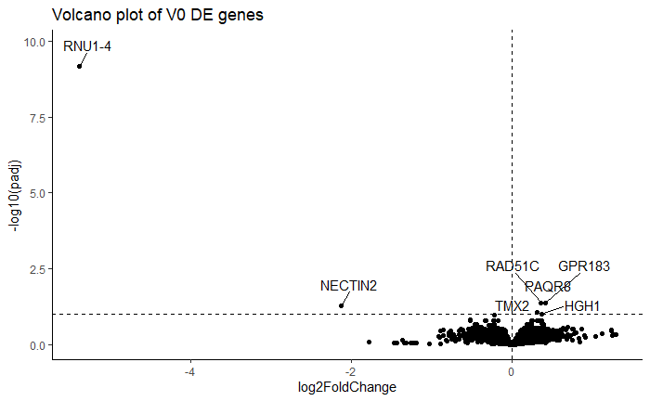
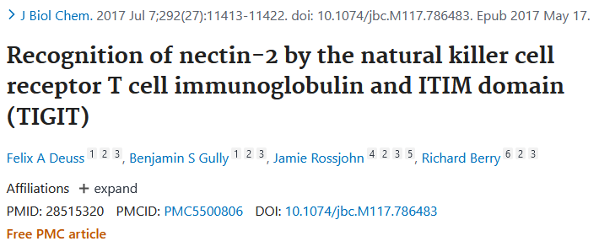
Promising genes are differentially expressed at V0
ds break repair by homologous recombination, cancer protection gene
Progesterone receptor
GPCR (aka EBI2B cell chemotaxis in lymph nodes)
Nuclear RNA (???)
Membrane glycoprotein (stimulates or inhibits T cells)
Notes:
TMX2 – thioredoxin
HGH1 – chaperone
Progesterone-oxLDL costimulation attenuates TNFa production (oxLDL-induced trained immunity) in monocytes
Nectin-2 attenuates NK activity

Slide 11
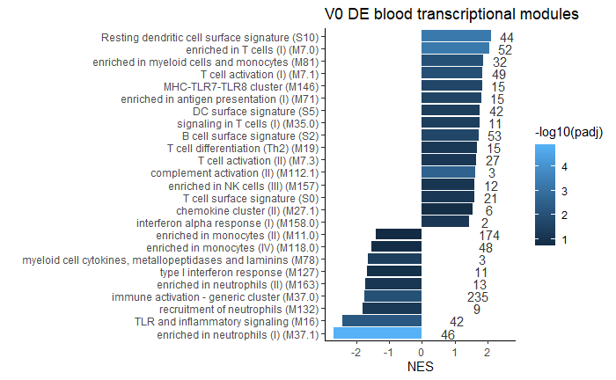
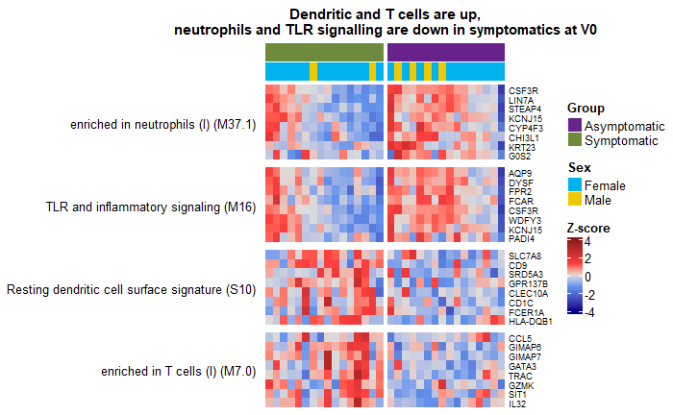
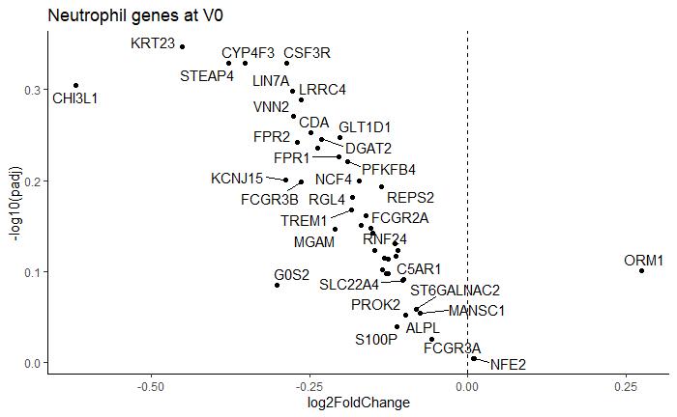
BTMs differentially expressed at V0

Slide 12
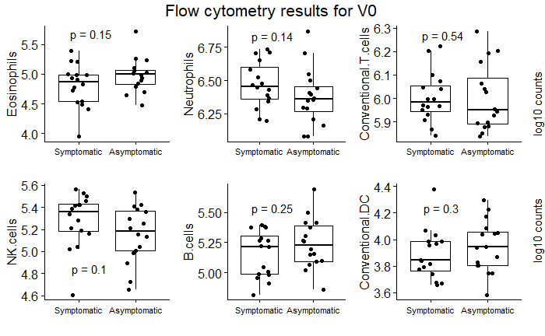
Flow cytometry finds increase in NK cells in symptomatic group at V0
V0 changes from GSEA
Up | T cells, dendritic cells
Down | Neutrophils*

Slide 13
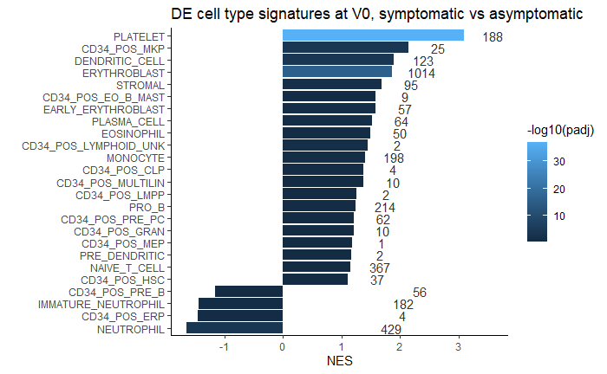
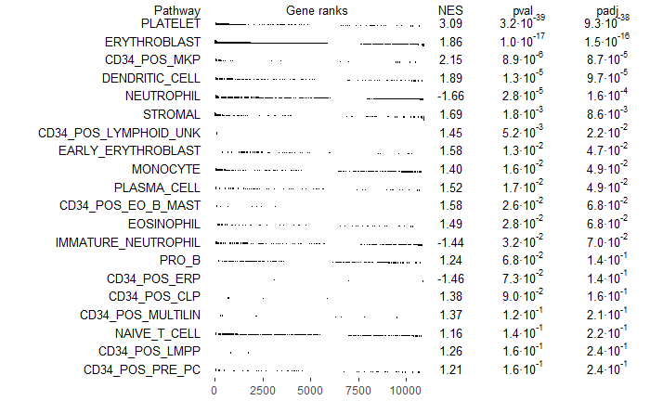
Caution: cell proportions affect GSEA interpretation!

Slide 14
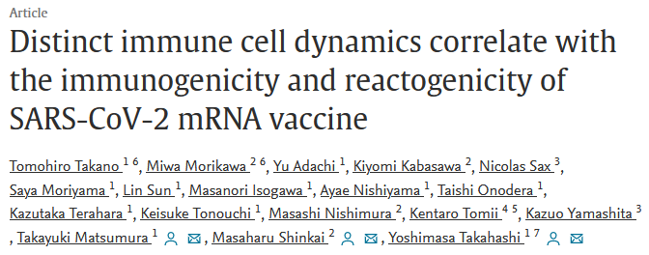
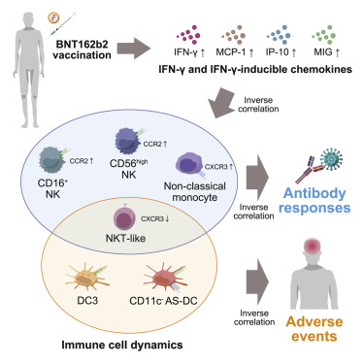
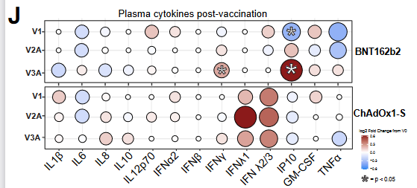
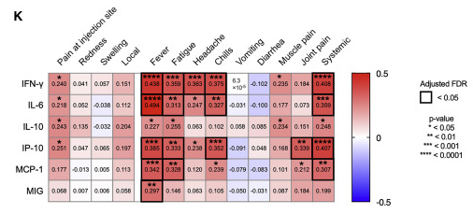
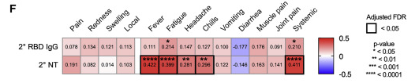
Summary slide
V2: symptomatic people have lower blood B cell count, potentially more active NK and T cells
V0: symptomatic people have potentially less active T cells and neutrophils, potentially more active T and dendritic cells, and an under-expressed mystery RNA
After second dose: NK count goes up acutely, then B cells migrate to lymph
At day 1…

Slide 15
Thank you
Thank you
Thank you
Thank you
Thank you

